Slide 1
Arrays

Slide 2
One-Dimensional Arrays
One-dimensional array
A structured collection of components, all of the same type, that is given a single name; each component is accessed by an index that indicates the component's position within the collection
Array
composite, structured
homogeneous
access by position

Slide 3
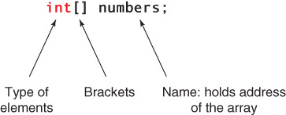
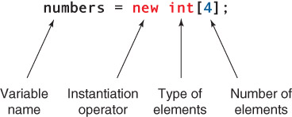
Declaration and Instantiation of Array
Declare
Instantiate

Slide 4
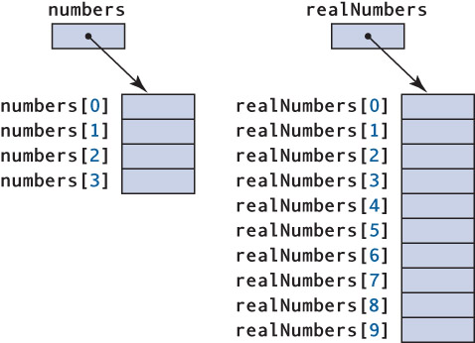
One-Dimensional Arrays
int[] numbers = new int[4];
What
type of
values
can be
stored in
each cell
?

Slide 5
One-Dimensional Arrays
float[] realNumbers = new float[10];
How
do you
get
values
into the
cells
?

Slide 6
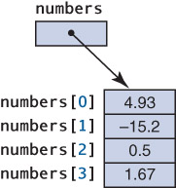
Array Initialization
Array Initializers
int[] numbers = {4.93, -15.2, 0.5, 1.67};
Initializers
do the
instantiation
and
storing in
with the
declaration

Slide 7
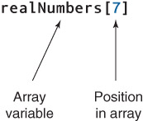
Accessing Individual Components
Indexing expression

Slide 8
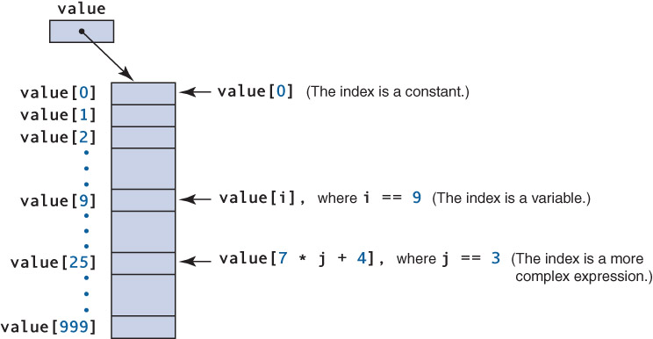
One Dimensional Array
What
happens
if you
try to
access
value[1000]
?

Slide 9
Out-of-bounds array index
An index that is either less than 0 or greater than the array size minus 1, causing an ArrayIndexoutOfBoundsException to be thrown
Length
A public instance variable associated with each instantiated array, accessed by
array name.length
Use length to avoid out-of-bounds indexes

Slide 10
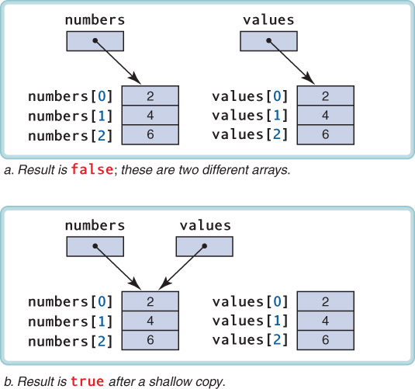
Aggregate Array Operations
What does the following expression return?
numbers == values

Slide 11
Now, what does the following expression return?
numbers == values

Slide 12
System provides two useful array methods
first = second.clone(); // duplicates second import java.util.Arrays;
Arrays.equals(first, second); // item-by-item check
System.out.println(first == second);
System.out.println(Arrays.equals(first, second);
What is printed?

Slide 13
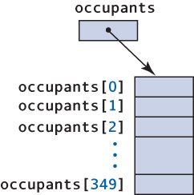
What does this code segment do?
totalOccupants = 0;
for (int aptNo = 0; aptNo < occupants.length; aptNo++)
totalOccupants = totalOccupants +occupants[aptNo];

Slide 14
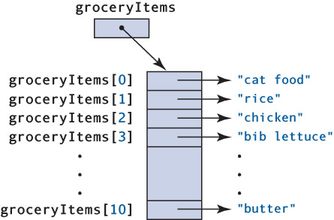
Array of Objects
String[] groceryItems = new String[10];
for (index = 0; index < grocerItems.length; index++)
{
groceryItems[index] = inFile.nextLine();
}

Slide 15
length is the number of slots assigned to the array
What if the array doesn’t have valid data in each of these slots?
Keep a counter of how many slots have valid data and use this counter when processing the array

Slide 16
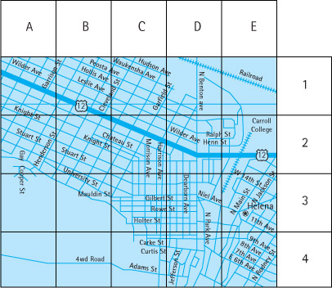
Two Dimensional Array
Two-
dimensional
arrays
can be
used to
represent
tables
such as
this map

Slide 17
Two-dimensional array
A collection of homogeneous components, structured in two dimensions (referred to as rows and columns); each component is accessed by a pair of indexes representing the component’s position within each dimension

Slide 18
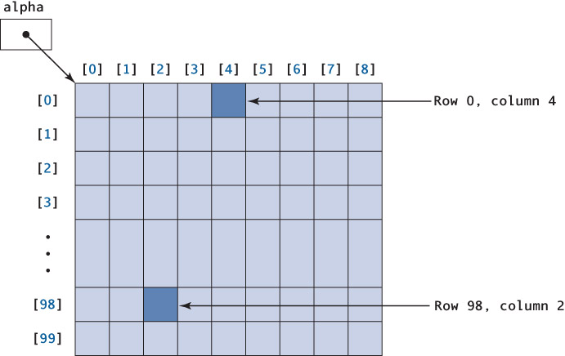
Two-dimensional array

Slide 19
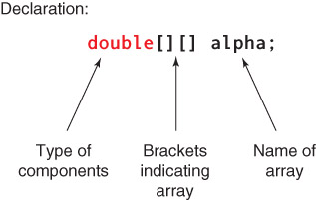
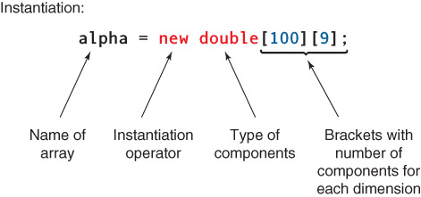
Declaration and Instantiation of 2D array
Can you predict how each item is accessed?

Slide 20
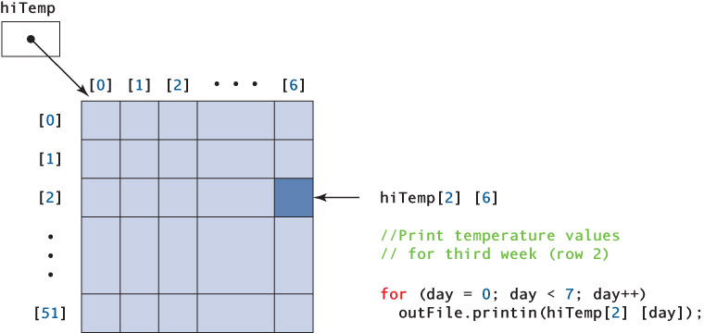
Accessing the individual element in 2D array

Slide 21
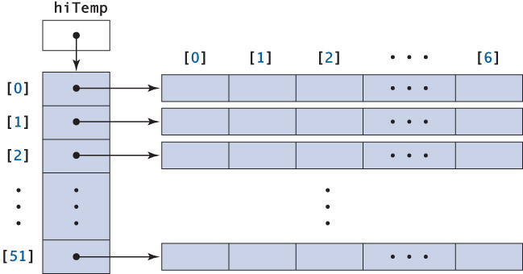
Actual JAVA implementation
Actual Java implementation

Slide 22
hiTemp.length is the number of rows
hiTemp[2].length is the number of columns in row two

Slide 23
When processing by row,
the outer loop is ______ (row, column)?
the inner loop is ______ (row, column)?
When processing by column,
the outer loop is ______ (row, column)?
the inner loop is ______ (row, column)?

Slide 24
Variable Length array
No of columns in each row are not same.
Creating variable length array:
int[ ][ ] a;
a=new int[10][ ];
If no of columns are not known then second subscript can be kept blank.
Then to allocate memory for columns in each row
a[0]=new int[5];

Slide 25
Initializing 2D array
Initializer Lists
int[][] hits = {{ 2, 1, 0, 3, 2 },
{ 1, 1, 2, 3 },
{ 1, 0, 0, 0, 0 },
{ 0, 1, 2, 1, 1 }};
To display the elements present in the an array :
for(int i=0; i<hits.length; i++) //hits.length gives no of rows
for(int j=0; j<hits[i].length; j++) //hits[i].length gives no of columns in i^{th} row
System.out.println(“hits[“ + (i+1) + ”][“ + (j+1) + “]=” +hits[i][j]);

Slide 26
Thank you

